Slide 1



Investigation of Central Pit Craters in the Southern Hemisphere of Mercury
Shayne Quinn
Mentor:
Dr. Nadine Barlow
Institution:
Northern Arizona University

Slide 2
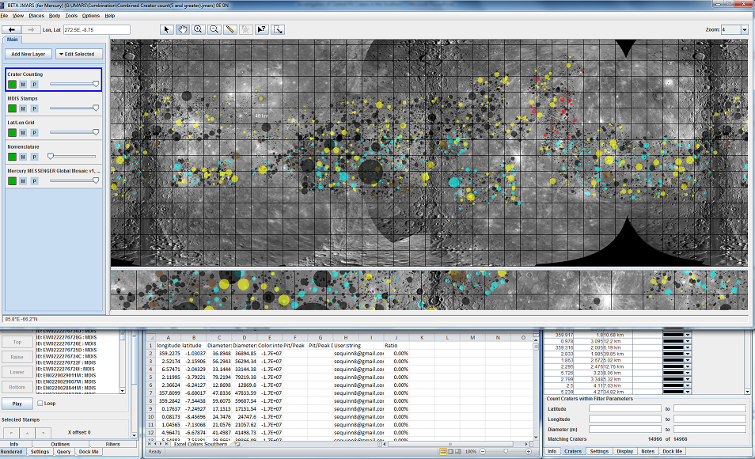
System Layout

Slide 3
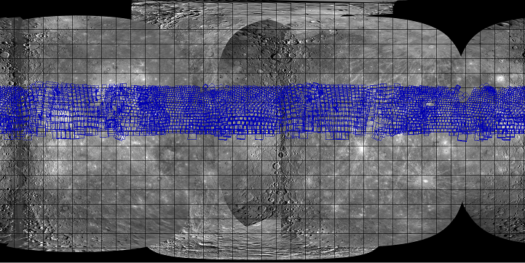
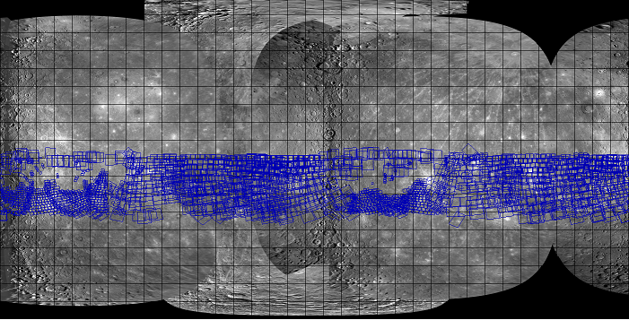
Imaging Distribution
Northern Hemisphere
30° North
0 ° Equator
-Due to Messengers orbit there are certain sections that do not currently have usable images.
Southern Hemisphere
0° Equator
30 ° South

Slide 4
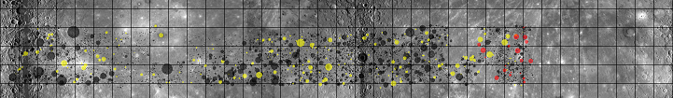
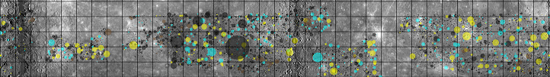
Crater Distribution
30° North
0 ° Equator
Northern Hemisphere:
Latitude: 0° to +30 °
Longitude: 0 ° to +360 °
Total Documented:
Craters 6,562 Craters
250 Focus Group
Southern Hemisphere:
Latitude: 0° to -30 °
Longitude: 0 ° to +360 °
Total Documented:
8,256 Craters
305 Focus Group
0° Equator
-30 ° South

Slide 5
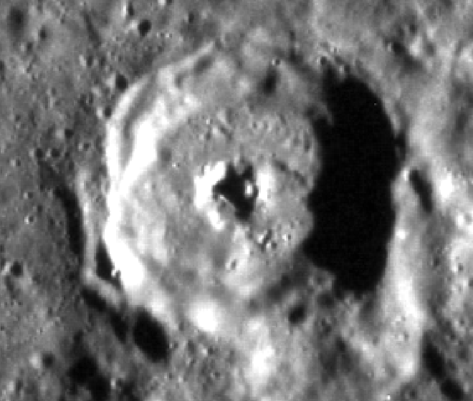
Central Pit Data
Diameter Range:
Pit- 2.0km to 19.0km
Crater- 11.8km to 105.6km
Mean Diameters:
Pit- 7.89km
Crater- 42.73km
Ratio- 0.185
Current Pit crater count: 18
Percent: 0.12%

Slide 6
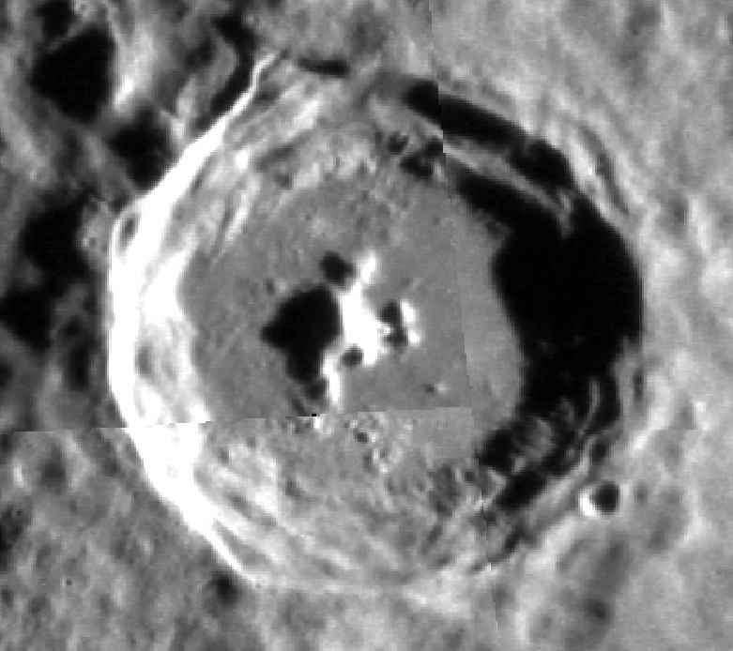
Central Peak Data
Diameter Range:
Peak- 2.0km to 42.0km
Crater- 10.4km to 157.0km
Mean Diameters:
Peak- 8.52km
Crater- 41.54km
Ratio- 0.205
Current Peak crater count: 538
Percent: 3.63%

Slide 7
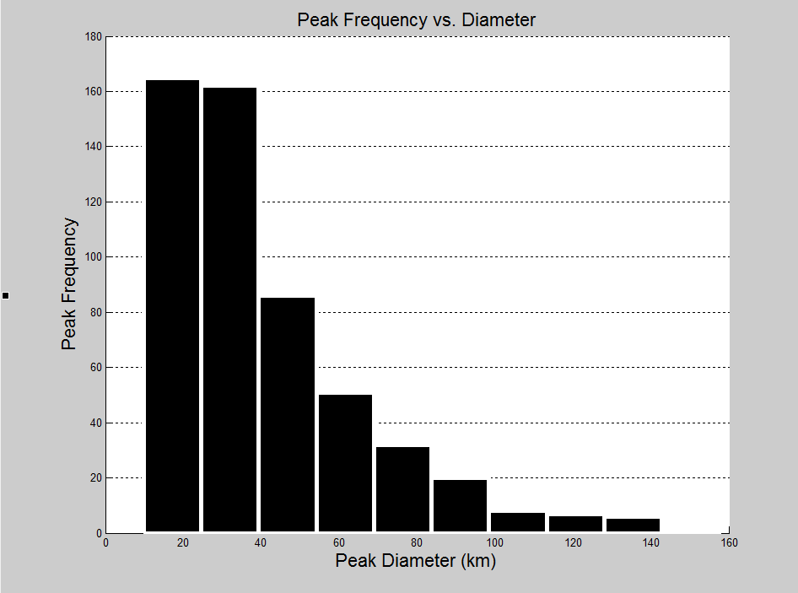
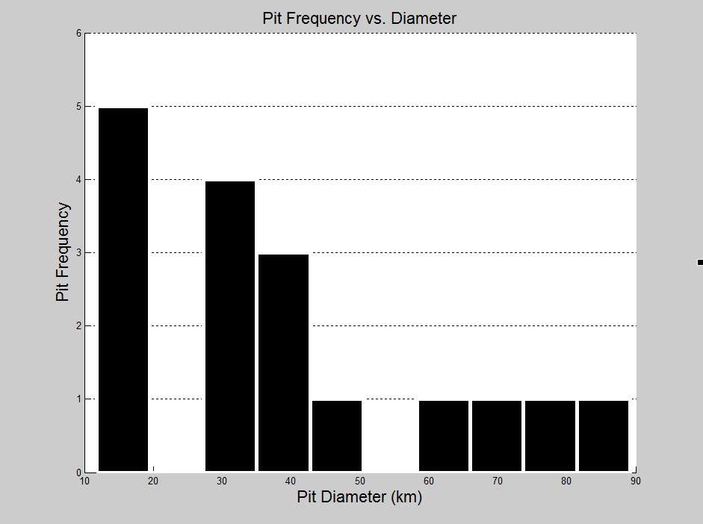
Analysis

Slide 8
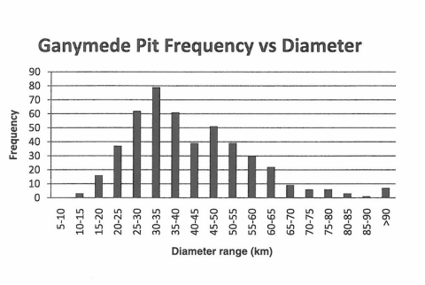
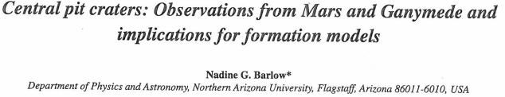
Comparison of Mercury and Ganymede
The preliminary results are presenting a less frequent occurrence of Central Pit Craters on Mercury.
Additionally the average ratio of Pit Diameter to Crater Diameter is similar to that of Ganymede

Slide 9
Future Goals
We plan to finish:
The distribution maps
Continue the documentation 30º to 90ºN & -30º to -90ºS.
Pit Diameter to crater diameter comparisons
Full planet evaluation

Slide 10

Acknowledgement
-NAU/NASA Space Grant
-ASU for supplying JMARS
-MESSENGER Team
-Kathleen Stigmon
-Dr. Nadine Barlow

